Slide 1
DFS-BFS

Slide 2
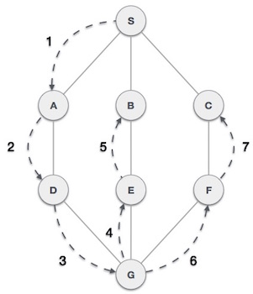
DFS- Depth First Search
Depth First Search (DFS) algorithm traverses a graph in a depthward motion and uses a stack to remember to get the next vertex to start a search when a dead end occurs in any iteration.

Slide 3
As in the example given, DFS algorithm traverses from S to A to D to G to E to B first, then to F and lastly to C. It employs the following rules.
Rule 1 − Visit the adjacent unvisited vertex. Mark it as visited. Display it. Push it in a stack.
Rule 2 − If no adjacent vertex is found, pop up a vertex from the stack. (It will pop up all the vertices from the stack, which do not have adjacent vertices.)
Rule 3 − Repeat Rule 1 and Rule 2 until the stack is empty.

Slide 4
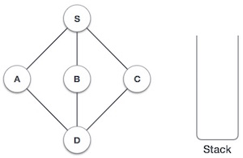
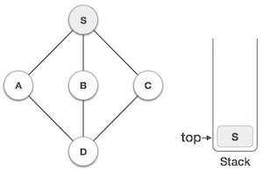
Initialize the stack.
Mark S as visited and put it onto the stack. Explore any unvisited adjacent node from S. We have three nodes and we can pick any of them. For this example, we shall take the node in an alphabetical order.

Slide 5
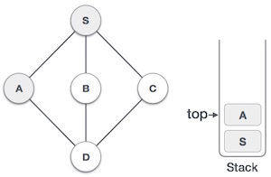
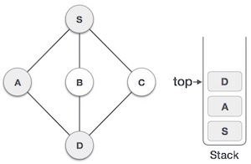
Mark A as visited and put it onto the stack. Explore any unvisited adjacent node from A. Both S and D are adjacent to A but we are concerned for unvisited nodes only.
Visit D and mark it as visited and put onto the stack. Here, we have B and C nodes, which are adjacent to D and both are unvisited. However, we shall again choose in an alphabetical order.

Slide 6
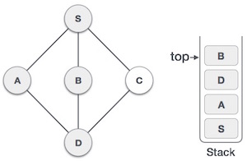
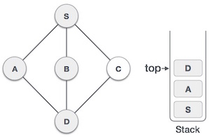
We choose B, mark it as visited and put onto the stack. Here B does not have any unvisited adjacent node. So, we pop B from the stack.
We check the stack top for return to the previous node and check if it has any unvisited nodes. Here, we find D to be on the top of the stack.

Slide 7
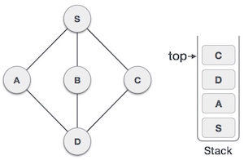
Only unvisited adjacent node is from D is C now. So we visit C, mark it as visited and put it onto the stack.
As C does not have any unvisited adjacent node so we keep popping the stack until we find a node that has an unvisited adjacent node. In this case, there's none and we keep popping until the stack is empty.

Slide 8
DFS Algorithm
The concept is to visit all the neighbor vertices of a neighbor vertex before visiting the other neighbor vertices.
Initialize status of all nodes as “Ready”
Put source vertex in a stack and change its status to “Waiting”
Repeat the following two steps until stack is empty −
Pop the top vertex from the stack and mark it as “Visited”
Push onto the top of the stack all neighbors of the removed vertex whose status is “Ready”. Mark their status as “Waiting”.

Slide 9
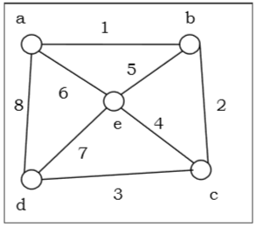
Problem
Let us take a graph (Source vertex is ‘a’) and apply the DFS algorithm to find out the traversal order.

Slide 10
Solution
Initialize status of all vertices to “Ready”.
Push a in stack and change its status to “Waiting”.
Pop a and mark it as “Visited”.
Push a’s neighbors in “Ready” state e, d and b to top of stack and mark them as “Waiting”.
Pop b from stack, mark it as “Visited”, push its “Ready” neighbor c onto stack.
Pop c from stack and mark it as “Visited”. It has no “Ready” neighbor.
Pop d from stack and mark it as “Visited”. It has no “Ready” neighbor.
Pop e from stack and mark it as “Visited”. It has no “Ready” neighbor.
Stack is empty. So stop.

Slide 11
So the traversal order is −
a → b → c → d → e
The alternate orders of traversal are −
a → e → b → c → d
Or, a → b → e → c → d
Or, a → d → e → b → c
Or, a → d → c → e → b
Or, a → d → c → b → e

Slide 12
Applications
Detecting cycle in a graph
To find topological sorting
To test if a graph is bipartite
Finding connected components
Finding the bridges of a graph
Finding bi-connectivity in graphs
Solving the Knight’s Tour problem
Solving puzzles with only one solution

Slide 13
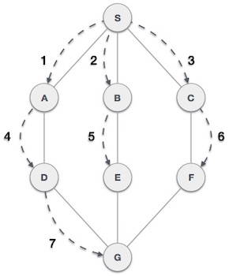
BFS-Breadth First Traversal
Breadth First Search (BFS) algorithm traverses a graph in a breadthward motion and uses a queue to remember to get the next vertex to start a search, when a dead end occurs in any iteration.

Slide 14
As in the example given, BFS algorithm traverses from A to B to E to F first then to C and G lastly to D. It employs the following rules.
Rule 1 − Visit the adjacent unvisited vertex. Mark it as visited. Display it. Insert it in a queue.
Rule 2 − If no adjacent vertex is found, remove the first vertex from the queue.
Rule 3 − Repeat Rule 1 and Rule 2 until the queue is empty.

Slide 15
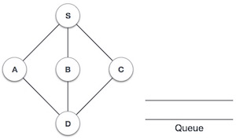
Initialize the queue.
We start from visiting S (starting node), and mark it as visited.

Slide 16
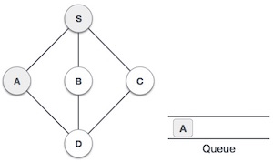
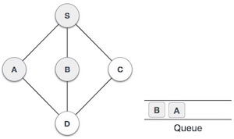
We then see an unvisited adjacent node from S. In this example, we have three nodes but alphabetically we choose A, mark it as visited and enqueue it.
Next, the unvisited adjacent node from S is B. We mark it as visited and enqueue it.

Slide 17
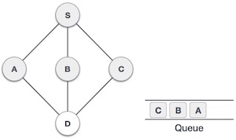
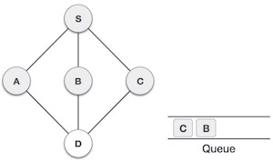
Next, the unvisited adjacent node from S is C. We mark it as visited and enqueue it.
Now, S is left with no unvisited adjacent nodes. So, we dequeue and find A.

Slide 18
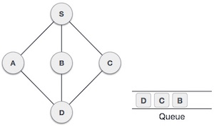
From A we have D as unvisited adjacent node. We mark it as visited and enqueue it.
At this stage, we are left with no unmarked (unvisited) nodes. But as per the algorithm we keep on dequeuing in order to get all unvisited nodes. When the queue gets emptied, the program is over.

Slide 19
BFS Algorithm
The concept is to visit all the neighbor vertices before visiting other neighbor vertices of neighbor vertices.
Initialize status of all nodes as “Ready”.
Put source vertex in a queue and change its status to “Waiting”.
Repeat the following two steps until queue is empty −
Remove the first vertex from the queue and mark it as “Visited”.
Add to the rear of queue all neighbors of the removed vertex whose status is “Ready”. Mark their status as “Waiting”.

Slide 20
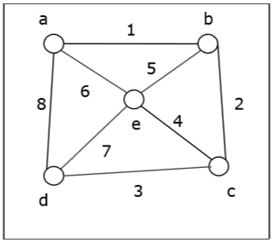
Problem
Let us take a graph (Source vertex is ‘a’) and apply the BFS algorithm to find out the traversal order.

Slide 21
Solution −
Initialize status of all vertices to “Ready”.
Put a in queue and change its status to “Waiting”.
Remove a from queue, mark it as “Visited”.
Add a’s neighbors in “Ready” state b, d and e to end of queue and mark them as “Waiting”.
Remove b from queue, mark it as “Visited”, put its “Ready” neighbor c at end of queue and mark c as “Waiting”.
Remove d from queue and mark it as “Visited”. It has no neighbor in “Ready” state.
Remove e from queue and mark it as “Visited”. It has no neighbor in “Ready” state.
Remove c from queue and mark it as “Visited”. It has no neighbor in “Ready” state.
Queue is empty so stop.

Slide 22
So the traversal order is −
a → b → d → e → c
The alternate orders of traversal are −
a → b → e → d → c
Or, a → d → b → e → c
Or, a → e → b → d → c
Or, a → b → e → d → c
Or, a → d → e → b → c

Slide 23
Application of BFS
Finding the shortest path
Minimum spanning tree for un-weighted graph
GPS navigation system
Detecting cycles in an undirected graph
Finding all nodes within one connected component

Slide 24
?

